Slide 1
NEW CORPORATE VALUES A PRACTICAL GUIDE For Leaders

Slide 2
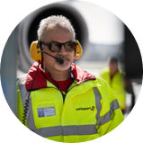
Our Corporate values
Win as a team
Do the right things
Show you care

Slide 3
Introduction why WE NEED NEW CORPORATE VALUES
Swissport is fully engaged on an exciting journey of cultural transformation.
The new Company Purpose, our Corporate Values, our Employee Value Proposition (EVP) and our Customer Value Proposition (CVP, tbd) set the framework for this transformation.
We are at the exciting point of bringing our values to life and deliver on the EVP – our promise to our people.
Our values are the cornerstone of our cultural priorities:
Give actionable(!) guidance for individual behavior
Set the framework for leadership principles
Help attract and retain the right talent
Serve as a compass for how to act and deliver
Set ourselves apart from our competitors
The long-term potential should not be under-estimated; it is a once in a decade moment for our business.
We are taking our people on a journey, which will influence the way we collaborate and deliver.
This takes time and patience and therefore requires strong leadership and communication.

Slide 4
Bringing our Values to life key events and activities
DD.12. (TBD)
Branded items to ensure visual presence of values beyond the launch phase.
11.07.
Swissport Updates on creating awareness for new corporate values and availability of posters and screens in 8 languages.
DD.09. (TBD)
Breakfast at HQI with Q&A on the values with Warwick and Chris
22.08.
Values as focus topic at Mgmt. Briefing and launch of microsite and toolbox.
DD.10. (TBD)
Podcast on where we currently stand and what the next steps are
February
July
August
September
October
November
December
14.02.
Kick-off in Las Vegas:
Values were presented to SP Management
02.08.
Letter by Chris Rayner on values and red rules
DD.10. (TBD)
Global recording of video statements by Swissport staff on meaning of values in everyday work life.
DD.12. (TBD)
Campaign wrap-up video showcasing changes
14.09.
Round table w/ Chris Rayner, James Hulbert, Marina Bottelli

Slide 5
Bringing our values to life microsite for leaders: Access here

Slide 6
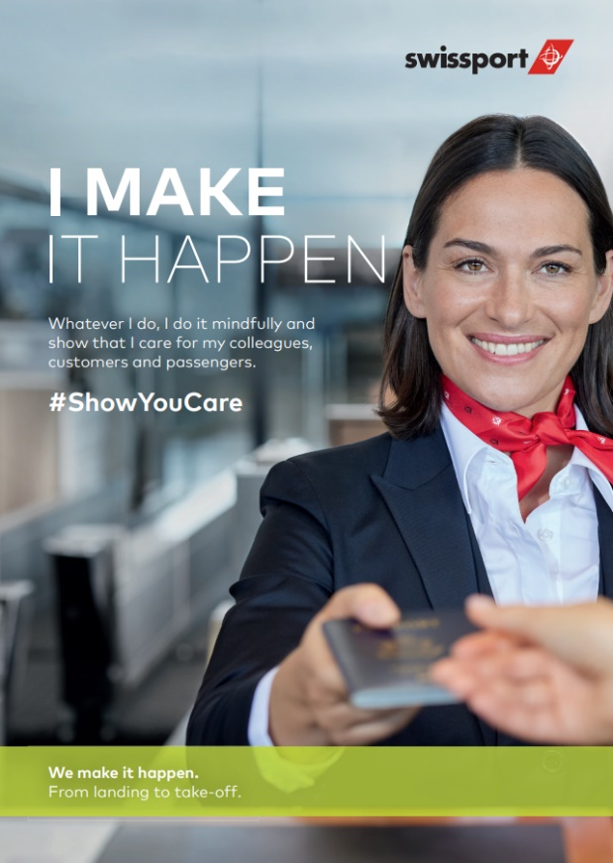
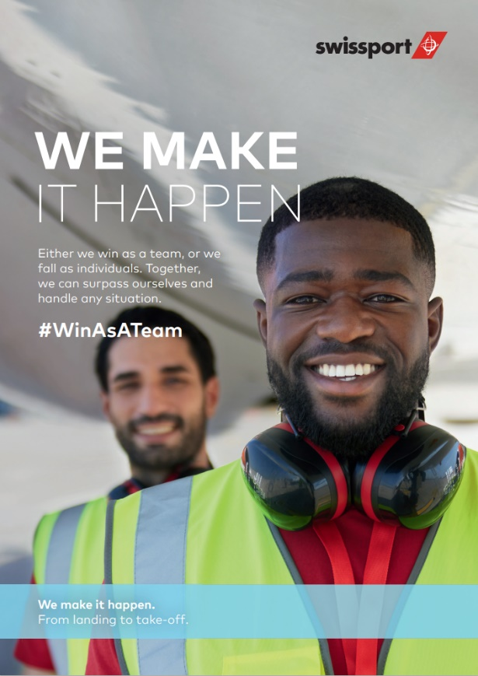
Our Key visuals An emotional framing

Slide 7
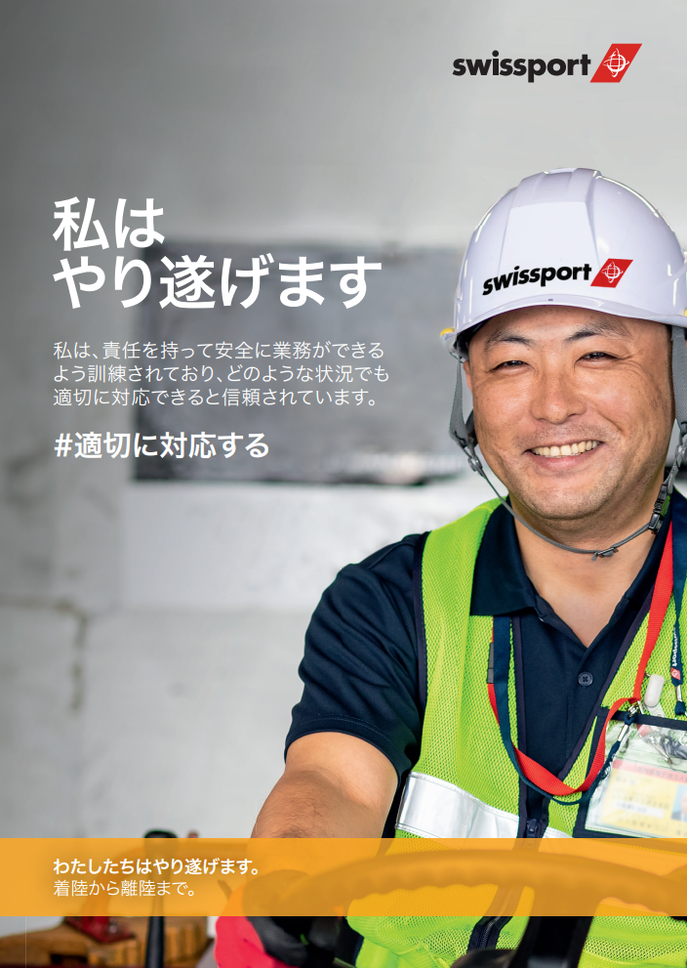
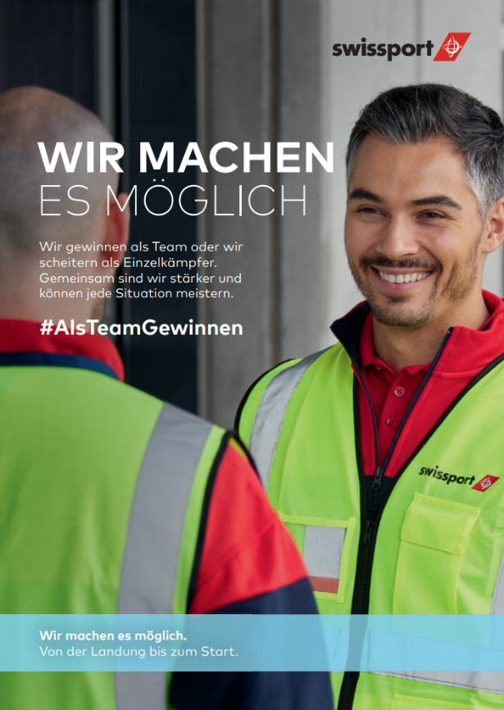
Our Key visuals An emotional framing

Slide 8
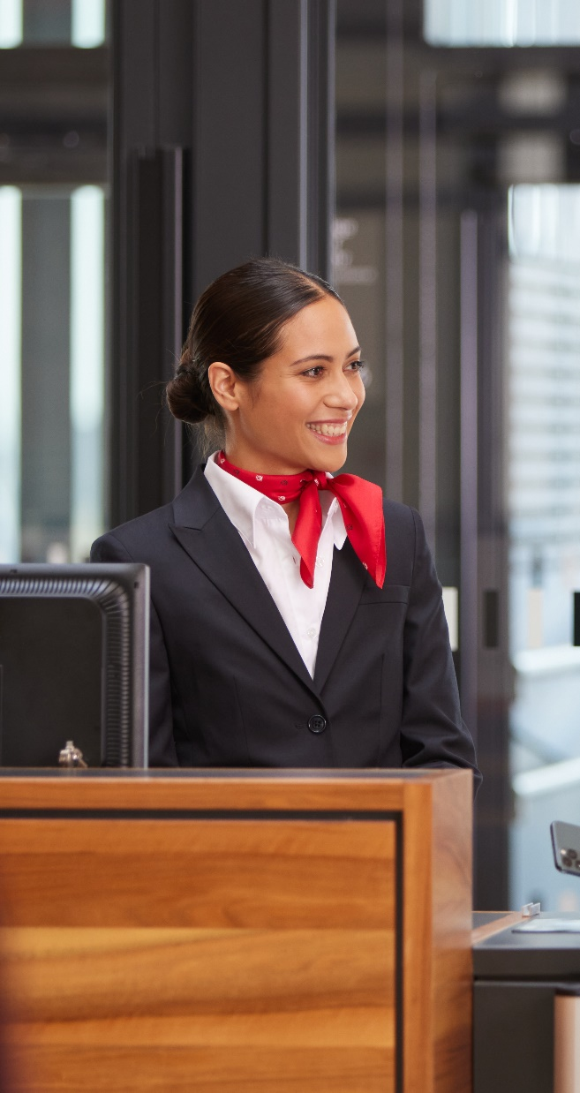
Our Corporate Values guide us on how to act and deliver.
Notes:
Corporate values represent the «handles» of a company. They are what employees in every role across the entire company should consider when making decisions.
They need to be actionable, easy to understand, and easy to remember.

Slide 9
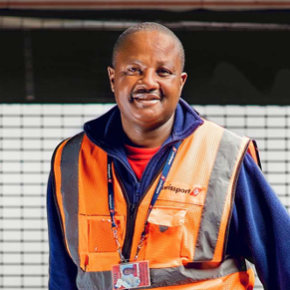
Show you care
Our actions are perceived and valued from the perspective of the people around us. So whatever we do, we do it purposefully and consciously, taking in the perspective of our colleagues, customers, and passengers.
Whenever you choose, choose to show that you care.

Slide 10
Show you care example situations
Ramp agent
A colleague's hearing protection came off, she/he didn't realize it.
You inform the colleague that her/his hearing is not protected properly.
Passenger service agent
A passenger with crutches checks in his luggage.
You inform this passenger that there is a transport service to the gate for people with reduced mobility.
Team leader / manager
You notice that the performance of one of your team members has decreased in the last weeks.
You engage in a conversation to find out what the reasons may be and whether the colleague needs support.

Slide 11
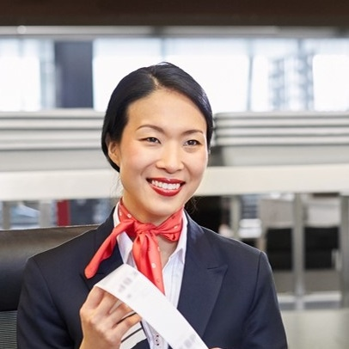
Do the right things
We do the things that are valuable to our colleagues,
customers, and passengers. We are trained to do this safely and trusted to do the right thing in any given situation.
Whenever you choose, choose to do the right things.

Slide 12
Do the right things example situations
Ramp agent
You see a luggage cart from another company is not sufficiently secured and could move.
You inform the other company's employees/supervisors so that they can secure the baggage carts.
Passenger service agent
A passenger is not sure if she/he forgot a power bank in the checked luggage.
You make sure that the passenger thoroughly searches the suitcase, to protect flight safety.
Team leader / manager
Safety and standard operating procedures (SOP) come before on-time performance (OTP).
You make sure that people only do what they are trained for – no shortcuts – despite staff shortages.

Slide 13
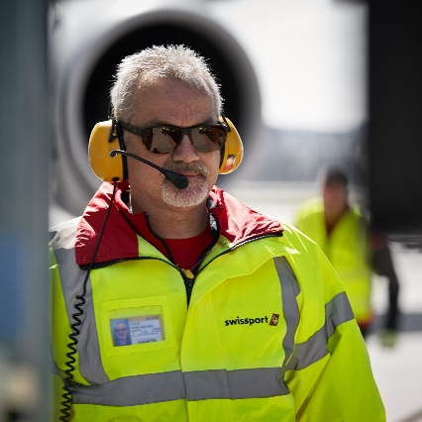
Win as a team
Either we win as a team, or we fall as individuals. Together,
we can surpass ourselves and handle any situation.
Whenever you choose, choose for the best of the team.

Slide 14
Win as a team examples and situations
Ramp agent
A colleague is behind in loading the aircraft and might cause a delay.
You help her/him load the aircraft, even though it's not part of our job.
Passenger service agent
A colleague must see the doctor in an emergency and wants to change shifts.
You check your agenda to see if it would be possible for you to swap shifts.
Team leader / manager
An important airline customer is asking for a discount that will put the contract in the red at your station.
Don’t take an isolated decision but reach out to Global Commercial to secure the best for the Group.

Slide 15
Delivering employee value red rules for the basics
Our “red rules” are the minimum standards we want to ensure at every workplace, front of house or back office, around the world.
A few examples:
Increase the stability of the shift plans to allow our shift workers to better plan their lives.
Invest in upgrading breakrooms for employees to recharge in recognition of extreme conditions on the apron, or high-pressure situations at the departure gates.
Properly train and (re-)qualify our people to do their job.
Ensure manageable average workload, even during peak season.
The red rules are designed to promote employee engagement and workplace satisfaction, because people work smarter, and stay longer when they are satisfied with their workplace environment and culture.
Notes:
Pay a fair wage
Allow your team to plan their life
Create a safe space to recharge
1
2
3
Pay fairly, according to your local market conditions
Provide a 28-day rolling roster with confirmed start/end times
We will minimize “last minute roster changes”
We will tell you if you can take your holidays within 7 days of receiving your request
We will create an environment where you can re-energize on rest breaks by offering appropriate amenities
Give people reasons to be proud of their job
Ensure competence & confidence
Share the workload
4
5
6
We will give you a uniform that keeps you safe and makes you look smart, so you feel proud to wear the Swissport badge
We will ensure everyone has the right skills training and the right badge to do their job and help you do yours
We will ensure we have the right number of people in the right place at the right time, so we share the work

Slide 16
THANK YOU LET’S DISCUSS

Slide 17
Backup

Slide 18
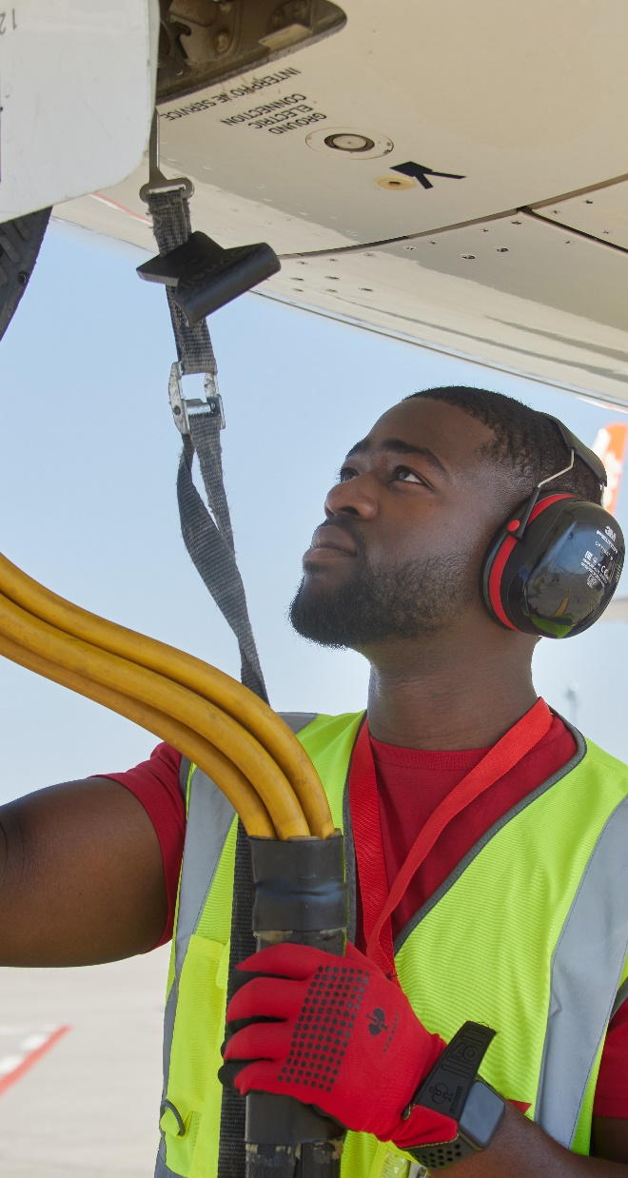
Our Company Purpose is our reason to exist in this industry.
Notes:
A purpose acts as the big picture. It is what we are all working for, from the check-in desk, tarmac and warehouse to the station management and the management board room.
It needs to have relevance for everyday situations in the workplace. And it must give room for growth.
It has to be concrete enough to be “lived”.

Slide 19
Our reason to exist
The world is a global village. People want to meet with each other and they need goods to be available to them.
Mega trends “Globalization” and “Mobility”
Therefore, flying remains an essential part of global mobility.
Our drive to act
But it is not just about flying. It is about making the time
between landing and take-off safe and smooth. This is critical to
our success.

Slide 20
Our company purpose
We make it happen. From landing to take-off.
Our services, efforts, and
action bring people and cargo
forward – all over the world.
Our work and commitment make it all
come together. Without us,
everything stands still.
We are active at the airport and in charge
of every moment between landing and
take-off. That is our universe, where we
act to make a difference.
We ensure reliable, smooth and safe operations. Every day.

Slide 21
Our new purpose embedded in a text
All our actions have a clear purpose.
We make it happen. From landing to take-off.
We contribute to steady operations of
our airline customers and help them deliver a
positive experience to their passengers.

Slide 22
The Employee Value Proposition is our promise to our people.
Notes:
An Employee Value Proposition (EVP) is what we can offer our employees, and what they can expect when working with us.
We need it to guide decisions in regards to recruitment and retention.
The EVP is true at every level of the company and is a driver of initiatives and actions.

Slide 23
Our Employee value proposition (EVP)
At Swissport, I work side by side with people I trust. Together, we get the job done, and we get it done safely. I am alert, ready and I grow as part of a team. I love the active energy of my airport as well as the international nature of the company. Every day, I am empowered to meet my customers' needs and appreciated for my commitment. I am always encouraged to find ways that brings me, and my team, forward.​

Slide 24
Our Employee value proposition Derivation of the EVP
At Swissport, I work side by side with people I trust. Together, we get the job done, and we get it done safely. I am alert, ready and I grow as part of a team. I love the active energy of my airport as well as the international nature of the company. Every day, I am empowered to meet my customers' needs and appreciated for my commitment. I am always encouraged to find ways that brings me, and my team, forward.​
Who do we want to attract and retain?
-> People who are accountable and committed to fulfilling the different aspects of their job.
-> People who seek personal growth working in a team and want to help others grow.

Slide 25
Our Employee value proposition Derivation of the EVP
At Swissport, I work side by side with people I trust. Together, we get the job done, and we get it done safely. I am alert, ready and I grow as part of a team. I love the active energy of my airport as well as the international nature of the company. Every day, I am empowered to meet my customers' needs and appreciated for my commitment. I am always encouraged to find ways that brings me, and my team, forward.​
What activity and workplace atmosphere are they looking for?
-> Airline industry and airport
-> International company
-> Proximity to passengers and aircraft

Slide 26
Our Employee value proposition Derivation of the EVP
How do we secure their success?
-> By empowering them to fulfill their job well through relevant tools and processes
-> By appreciating, enabling and encouraging them to grow.
At Swissport, I work side by side with people I trust. Together, we get the job done, and we get it done safely. I am alert, ready and I grow as part of a team. I love the active energy of my airport as well as the international nature of the company. Every day, I am empowered to meet my customers' needs and appreciated for my commitment. I am always encouraged to find ways that brings me, and my team, forward.​

